Slide 1


HACK YOUR CAREER
Hack.your.Career

Slide 2
AGILE Mythbusters

Slide 3
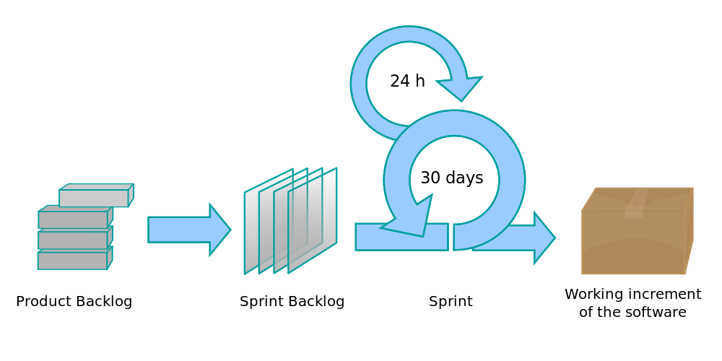

Slide 4
Scrum = art for art‘s sake

Slide 5
MYTH:
DEMO is about showing what’ve done in the sprint

Slide 6
Theory
A Sprint Review is held at the end of the Sprint to inspect the Increment and adapt the Product Backlog if needed.
During the Sprint Review, the Scrum Team and stakeholders collaborate about what was done in the Sprint.
Attendees collaborate on the next things that could be done to optimize value.
This is an informal meeting!

Slide 7

Sprint Review - practice

Slide 8
BUSTED!
DEMO is about showing what’ve done in the sprint

Slide 9
MYTH:
Daily Scrum is used by managers to control employees

Slide 10
Theory
The Daily Scrum is a 15-minute time-boxed event for the Development Team to synchronize activities and create a plan for the next 24 hours.
This is done by inspecting the work since the last Daily Scrum and forecasting the work that could be done before the next one.

Slide 11
Daily Scrum - practice

Slide 12
BUSTED!
Daily Scrum is used by managers to control employees

Slide 13
MYTH:
Retrospective is useless.
It is about complaints.

Slide 14
Theory
Inspect how the last Sprint went with regards to people, relationships, process, and tools
Identify and order the major items that went well and potential improvements
Create a plan for implementing improvements to the way the Scrum Team does its work.

Slide 15
Retrospective - practice

Slide 16
BUSTED!
Retrospective is useless.
It is about complaints.

Slide 17
MYTH:
Planning = distribution of tasks.

Slide 18
Theory
The work to be performed in the Sprint is planned at the Sprint Planning.
Sprint Planning answers the following:
Topic One: What can be done this Sprint?
Topic Two: How will the chosen work get done?
The Sprint Goal is an objective set for the Sprint that can be met through the implementation of Product Backlog.

Slide 19
Planning - practice

Slide 20
BUSTED!
Planning = distribution of tasks.

Slide 21
MYTH:
Backlog grooming is useless.

Slide 22
Theory
Product Backlog refinement is the act of adding detail, estimates, and order to items in the Product Backlog.
This is an ongoing process in which the Product Owner and the Development Team collaborate on the details of Product Backlog items.
During Product Backlog refinement, items are reviewed and revised.

Slide 23
Backlog refinement - practice

Slide 24
BUSTED!
Backlog grooming useless.

Slide 25
MYTH:
Scrum is about controlling employees.

Slide 26
Theory
Daily Scrum is for synchronization and planning
Sprint Review is to inspect and adapt Backlog
Retrospective is for the team to inspect and adapt itself
Manager is usually NOT a stakeholder!

Slide 27
Reasons for Scrum - practice

Slide 28
BUSTED!
Scrum is about controlling employees.

Slide 29
MYTH:
Scrum team members have the same skills and knowledge.

Slide 30
Theory
Even Navy Seals soldiers have specializations.
You can’t be equally good in everything…
… but you should try to be T – shaped
Be ready and willing to take on a task, even if it is hard
Get out of your comfort zone if it can help

Slide 31
Universal team - practice

Slide 32
BUSTED!
Scrum team members have the same skills and knowledge.

Slide 33
MYTH:
Scrum works well only for IT.

Slide 34
Theory
Scrum
A framework within which people can address complex adaptive problems, while productively and creatively delivering products of the highest possible value.
It does not say it is IT- or software – only
Three pillars:
Transparency
Inspection
Adaptation
Notes:
Empirical framework

Slide 35
Scrum in other contexts - practice
Notes:
http://www.ted.com/talks/bruce_feiler_agile_programming_for_your_family

Slide 36
BUSTED!
Scrum works well only for IT.

Slide 37
MYTH:
‘Good’ team does not need Scrum.

Slide 38
Theory
What is a good team?
A framework within which people can address complex adaptive problems
Only works if core scrum values are also team’s values
Scope has to stay fixed for duration of the sprint

Slide 39
Scrum usefulness - practice

Slide 40
PLAUSIBLE
‘Good’ team does not need Scrum.

Slide 41
Scrum = art for art‘s sake ?

Slide 42
BUSTED!

Slide 43
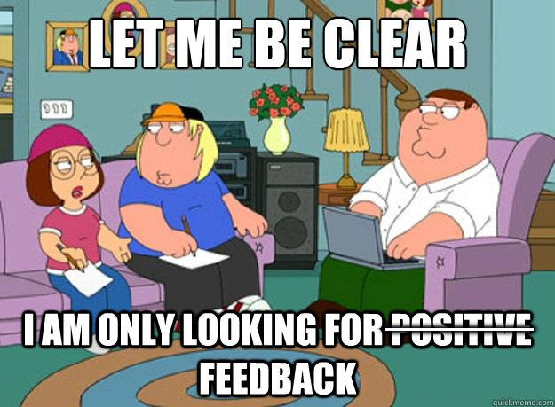
BUSTED!

Slide 44
References
http://www.scrumguides.org/scrum-guide.html
http://www.ted.com/talks/bruce_feiler_agile_programming_for_your_family
http://www.scrumyourwedding.com/

